Slide 1

Unit-5: Graph Algorithm, Branch and Bound, String Matching and NP-Completeness
Design and Analysis of Algorithm (DAA)
#2101CS401
Rupesh G. Vaishnav
Computer Engineering Department
rupesh.vaishnav@darshan.ac.in
9428037452

Slide 2

Outline
An introduction using Graphs
Undirected Graph
Directed Graph
Traversing Graphs
Depth First Search (DFS)
Breath First Search (BFS)
Topological sort
Connected components
Articulation point
Looping

Slide 3
Introduction to Graph

Slide 4
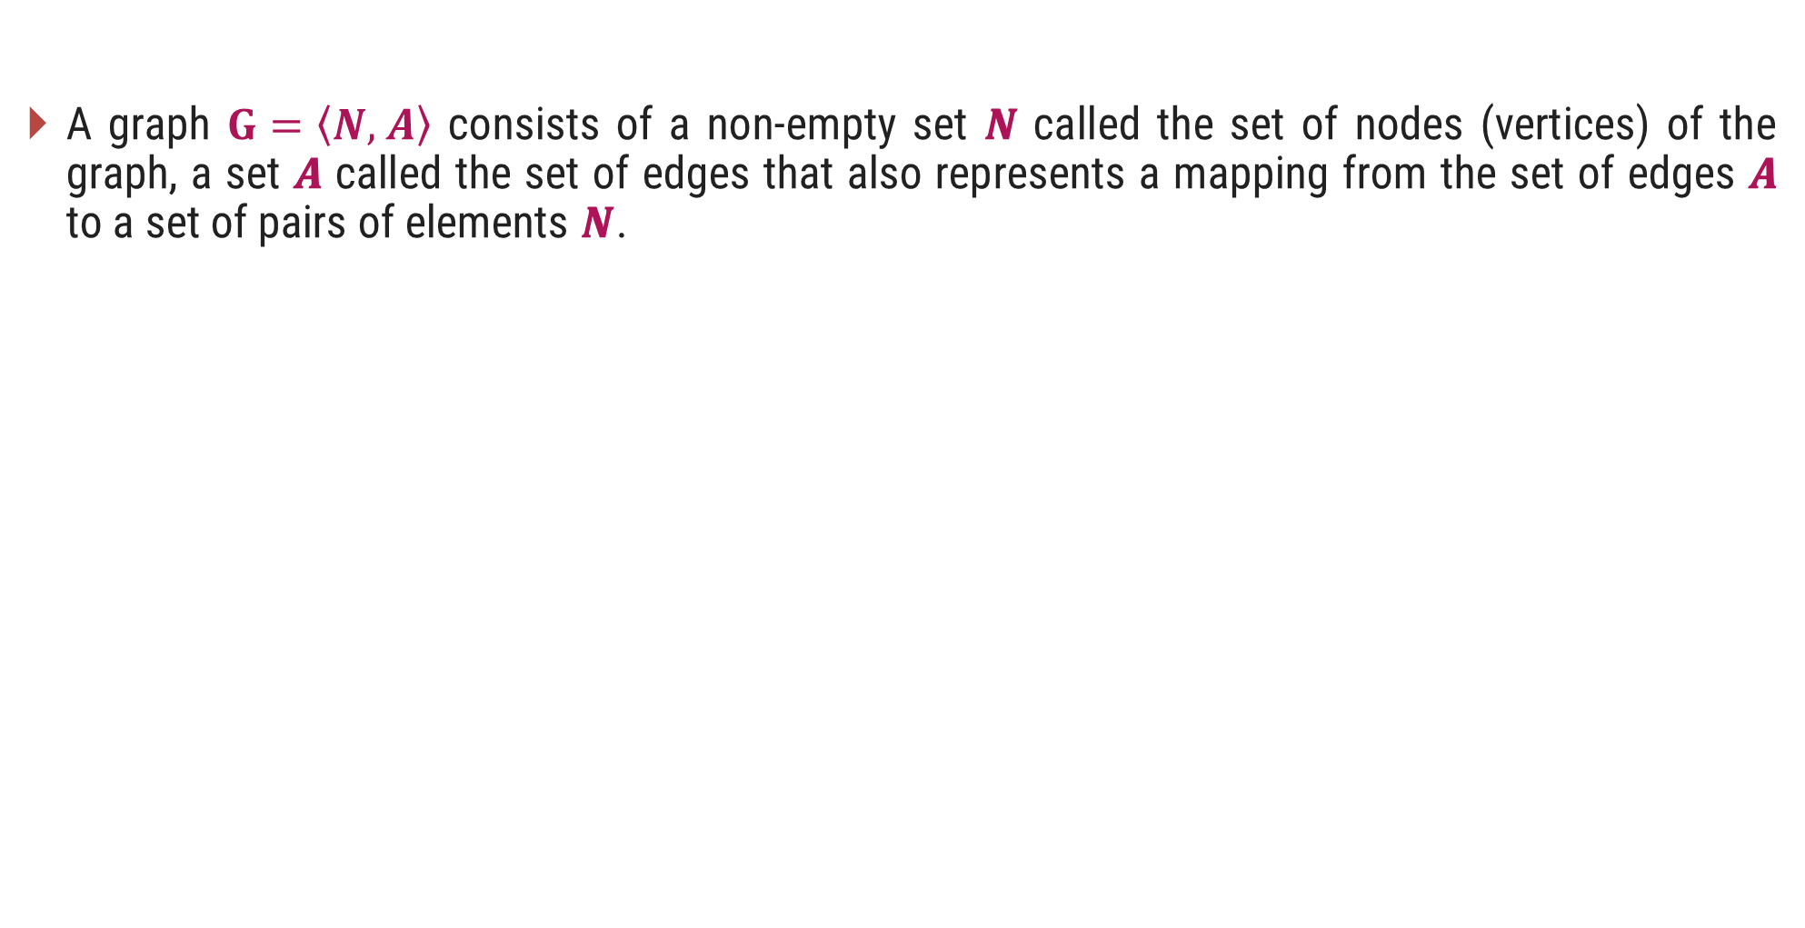
Graph - Definition
A graph $G=\left\langle N, \right.\left.A\right\rangle$ consists of a non-empty set 𝑵 called the set of nodes (vertices) of the graph, a set 𝑨 called the set of edges that also represents a mapping from the set of edges 𝑨 to a set of pairs of elements 𝑵.
edges
(or links)
D
A
E
C
B
F
nodes
(or vertices)

Slide 5
Directed & Undirected Graph
Directed Graph: A graph in which every edge is directed from one node to another is called a directed graph or digraph.
Undirected Graph: A graph in which every edge is undirected and no direction is associated with them is called an undirected graph.
Directed Graph
Undirected Graph

Slide 6
Traversing Graphs

Slide 7
Traversing Graph/Tree
Preorder
Visit the root.
Traverse the left sub tree in preorder.
Traverse the right sub tree in preorder.
In order
Traverse the left sub tree in in order.
Visit the root.
Traverse the right sub tree in in order.
Post order
Traverse the left sub tree in post order.
Traverse the right sub tree in post order.
Visit the root.

Slide 8
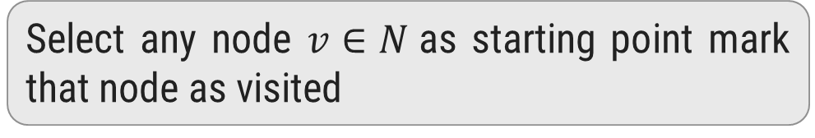
Depth-First Search / Traversal
1
Select any node $v∈N$as starting point mark that node as visited
2
3
4
Select one of the unvisited adjacents of current node.
Make it new starting point and mark it as visited
5
6
7
8
If new node has no unvisited adjacent then move to parent and make it starting point
Visited :
1
2
3
6
5
4
7
8

Slide 9
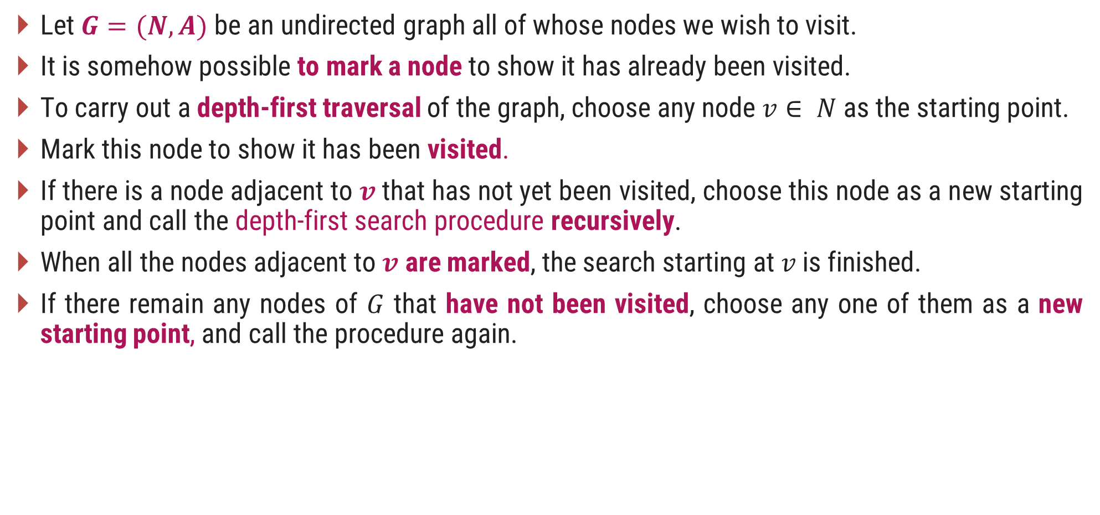
DFS – Procedure
Let $G=(N, A)$be an undirected graph all of whose nodes we wish to visit.
It is somehow possible to mark a node to show it has already been visited.
To carry out a depth-first traversal of the graph, choose any node $v∈ N$as the starting point.
Mark this node to show it has been visited.
If there is a node adjacent to $v$ that has not yet been visited, choose this node as a new starting point and call the depth-first search procedure recursively.
When all the nodes adjacent to $v$ are marked, the search starting at$v$is finished.
If there remain any nodes of $G$ that have not been visited, choose any one of them as a new starting point, and call the procedure again.

Slide 10
Depth-First Search Algorithm
procedure dfsearch(G)
for each v Є N do
mark[v] ← not-visited
for each v Є N do
if mark[v] ≠ visited
then dfs(v)
procedure dfs(v)
{Node v has not previously been visited}
mark[v] ← visited
for each node w adjacent to v do
if mark[w] ≠ visited
then dfs(w)

Slide 11
Depth-First Search - Algorithm
dfs(1) Initial call
dfs(2) recursive call
dfs(3) recursive call
dfs(6) recursive call
dfs(5) recursive call; progress is blocked
dfs(4) a neighbour of node 1 that has not been visited
dfs(7) recursive call
dfs(8) recursive call
There are no more nodes to visit
1
2
3
4
5
6
7
8
procedure dfs(v)
mark[v] ← visited
for each node w adjacent to v do
if mark[w] ≠ visited
then dfs(w)

Slide 12
Breadth First Search / Traversal
1
Select any node v ∈ N as starting point mark that node as visited.
2
3
4
Enqueue visited v node into queue Q
Dequeue a node from the front of queue.
Find it’s all unvisited adjacent nodes, mark as visited, enqueue into queue
5
6
7
8
1
2
3
4
5
6
7
8
Queue Q
Visited :
1
2
3
4
5
6
7
8

Slide 13
Breadth First Search - Algorithm
procedure bfs(v)
Q ← empty-queue
mark[v] ← visited
enqueue v into Q
while Q is not empty do
u ← first(Q)
dequeue u from Q
for each node w adjacent to u do
if mark[w] ≠ visited
then mark[w] ← visited
enqueue w into Q
procedure search(G)
for each v Є N do
mark[v] ← not visited
for each v Є N do
if mark[v] ≠ visited
then bfs(v)

Slide 14
Traverse Graph using DFS and BFS
A
B
C
E
D
F
DFS : A B D C E F
BFS : A B C D E F

Slide 15
Comparison of DFS and BFS
Depth First Search (DFS) Breath First Search (BFS)
DFS traverses according to tree depth. DFS reaches up to the bottom of a subtree, then backtracks.
BFS traverses according to tree level. BFS finds the shortest path to the destination.
It uses a stack to keep track of the next location to visit.
It uses a queue to keep track of the next location to visit.
DFS requires less memory since only nodes on the current path are stored.
BFS guarantees that the space of possible moves is systematically examined; this search requires considerably more memory resources.
Does not guarantee to find solution. Backtracking is required if wrong path is selected.
If there is a solution, BFS is guaranteed to find it.

Slide 16
Comparison of DFS and BFS
Depth First Search Breath First Search
If the selected path does not reach to the solution node, DFS gets stuck or trapped into an infinite loops.
BFS will not get trapped exploring an infinite loops.
The Time complexity of both BFS and DFS will be O(V + E), where V is the number of vertices, and E is the number of Edges.

Slide 17
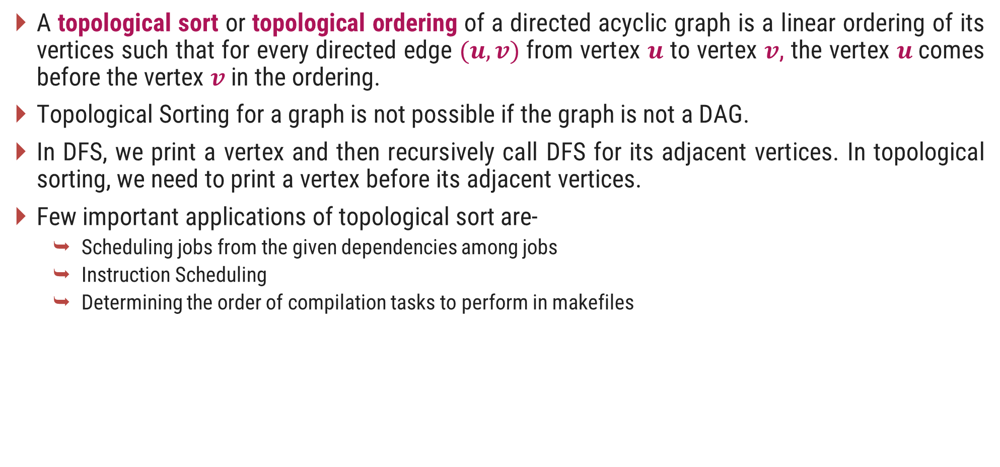
Topological Sorting
A topological sort or topological ordering of a directed acyclic graph is a linear ordering of its vertices such that for every directed edge $(u,v)$from vertex $u$ to vertex $v$, the vertex $u$comes before the vertex $v$ in the ordering.
Topological Sorting for a graph is not possible if the graph is not a DAG.
In DFS, we print a vertex and then recursively call DFS for its adjacent vertices. In topological sorting, we need to print a vertex before its adjacent vertices.
Few important applications of topological sort are-
Scheduling jobs from the given dependencies among jobs
Instruction Scheduling
Determining the order of compilation tasks to perform in makefiles

Slide 18
Topological Sorting – Example 1
B
C
Identify nodes having in degree ‘0’
Select a node and delete it with its edges then add node to output
A
F
D
E
Output:
A
B
C
D
E
F

Slide 19
Topological Sorting – Example 2
5
4
2
0
1
3
Output:
4
5
0
2
3
1

Slide 20
Connected Components
A connected component (or just component) of an undirected graph is a subgraph in which any two vertices are connected to each other by paths.
There are two connected components in the above undirected graph. 0 1 2 and 3 4
1
0
3
4
2

Slide 21
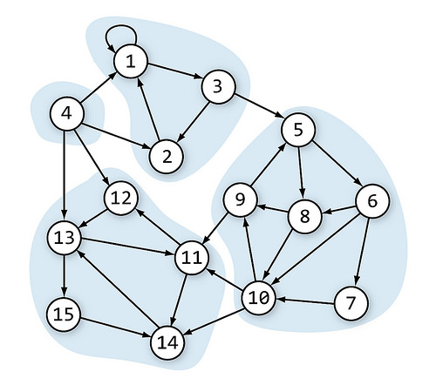
Connected Components
A directed graph is strongly connected if there is a directed path from any vertex to every other vertex.
This is same as connectivity in an undirected graph, the only difference is strong connectivity applies to directed graphs and there should be directed paths instead of just paths.
Similar to connected components, a directed graph can be broken down into Strongly Connected Components.

Slide 22
Articulation Point
An articulation point in a connected graph is a vertex, that if is deleted (and edges through it) then disconnects the graph.
It represent vulnerabilities in a connected network, single points whose failure would split network into two or more disconnected components.
For a disconnected undirected graph, an articulation point is a vertex removing which will increases number of connected components.
1
5
1
2
3
3
7
2
6
4
5
4
Articulation Points: 2,3
Articulation Points: 3

Slide 23

Outline
Backtracking
The N - queens problem
Branch & Bound
Knapsack problem
Travelling Salesman problem
Minimax principle
Looping

Slide 24
Backtracking

Slide 25
Introduction
Backtracking can be defined as a general algorithmic technique that considers searching every possible combination in order to solve an optimization problem.
It is a recursive technique.
It generates a state space tree for all possible solutions.
It traverse the state space tree in the depth first order.
So, in a backtracking we attempt solving a sub-problem, and if we don't reach the desired solution, then undo whatever we did for solving that sub-problem, and try solving another sub-problem.
All the solutions require a set of constraints divided into two categories: explicit and implicit constraints.

Slide 26
The N - Queen Problem
The 𝑁 - queen is the problem of placing N chess queens on an 𝑁×𝑁 chessboard so that, no two queens attack each other.
Two queens of same row, same column or the same diagonal can attack each other.
K-Promising solution: A solution is called k-promising if it arranges the k - queens in such a way that, they can not threat each other.
Q
Q
Q
Q
 | Q
1 - Promising Solution
0 - Promising Solution
0 - Promising Solution
0 - Promising Solution

Slide 27
The 4 - Queen Problem
 | 1 | 2 | 3 | 4
 | Q
 | 1 | 2 | 3 | 4
 | Q
 | Q | Q | Q
 | Q | Q | Q | Q
 | 1 | 2 | 3 | 4
 |  |  | Q
 | Q
 | Q | Q | Q | Q
 | Q | Q
1 - Promising
2 - Promising
4 – Promising <3, 1, 4, 2>
 | 1 | 2 | 3 | 4
1 |  | Q
2 |  |  |  | Q
3 | Q
4 |  |  | Q
Above 4-promising solution can be written as <3, 1, 4, 2>
Another possible solution is <2, 4, 1, 3>
4 – Promising <2, 4, 1, 3>

Slide 28
N - Queen Problem
Number of Queens | Possible Solutions
1 | 1
2 | 0
3 | 0
4 | 2
5 | 10
6 | 4
7 | 40
8 | 92
9 | 352
10 | 724

Slide 29
N - Queen Problem Solution
Here, suppose queen position is $(2, 3)$.
To identify the positions that can not be chosen, so that the queen does not attack.
The diagonal positions which are under attack are denoted as,
 | 1 | 2 | 3 | 4
1
2 |  |  | Q
3
4
Same Row | Same Col | Same Diagonal
$$(2, 1)$$ | $$(1, 3)$$ | $$(1, 4)$$ | $$(1, 2)$$
$$(2, 2)$$ | $$(3, 3)$$ | $$(3, 2)$$ | $$(3, 4)$$
$$(2, 4)$$ | $$(4, 3)$$ | $$(4, 1)$$
$$Row−Col$$
$$Row+Col$$

Slide 30
1
 | 1 | 2 | 3 | 4
1 |  | Q
2 |  |  |  | Q
3 | Q
4 |  |  | Q
2
[2,0,0,0]
4
[2,4,0,0]
[2,4,1,0]
Sol =
[2,4,1,3]
K =
3
col =
{2,4}
{2}
diag45 =
{2}
{2,3,-2}
{2,4,1}
{2,3}
diag135 =
{2,5}
{2}
{2,5,4}
procedure queens (k, col, diag45, diag135)
{sol[1..k] is k-promising,
col = {sol[i] | 1≤i≤k},
diag45 = {sol[i]–i+1 | 1≤i≤k}, and
diag135 = {sol[i]+i–1 | 1≤i≤k}}
if k = 4 then
write sol
else
for j ← 1 to 4 do
if j ∉ col and j – k ∉ diag45 and j + k ∉ diag135
then sol[k+1]← j
queens(k + 1, col U {j}, diag45 U {j - k}, diag135 U {j + k})
1- Promising
2- Promising
3- Promising
4- Promising
j + k = 2
j + k = 5
j - k = -1
j + k = 3
j - k = 0
j - k = 2
j = 1
j - k = 3
j = 2
j = 3
j = 4
j = 1

Slide 31
N – Queen Algorithm
sol[1…8] is global array, for all solutions to the eight queens problem call queens (0, ∅, ∅, ∅)
procedure queens (k, col, diag45, diag135)
{sol[1..k] is k-promising,
col = {sol[i] | 1≤i≤k},
diag45 = {sol[i]–i+1 | 1≤i≤k}, and
diag135 = {sol[i]+i–1 | 1≤i≤k}}
if k = 8 then {an 8-promising vector is a solution}
write sol
else {explore (k+1)-promising extensions of sol }
for j ← 1 to 8 do
if j ∉ col and j – k ∉ diag45 and j + k ∉ diag135
then sol[k+1]← j
{sol[1..k+1] is (k+1)-promising}
queens(k + 1, col U {j}, diag45 U {j - k}, diag135 U {j + k})

Slide 32
Branch & Bound

Slide 33
Introduction
The branch and bound approach is based on the principle that the total set of feasible solutions can be partitioned into smaller subsets of solutions.
These smaller subsets can then be evaluated systematically until the best solution is found.
Branch and bound is an algorithm design approach which is generally used for solving combinatorial optimization problems.
These problems are typically exponential in terms of time complexity and may require exploring all possible permutations in worst case.
The Branch and Bound Algorithm technique solves these problems relatively quickly.

Slide 34
Knapsack Problem
Let us consider the 0/1 Knapsack problem to understand Branch and Bound.
The Backtracking Solution can be optimized if we know a bound on best possible solution subtree rooted with every node.
If the best in subtree is worse than current best, we can simply ignore this node and its subtrees.
So, we compute bound (the best solution) for every node and compare the bound with current best solution before exploring the node.
We are given a certain number of objects and a knapsack.
Instead of supposing that we have n objects available, we shall suppose that we have n types of object, and that an adequate number of objects of each type are available.
Our aim is to fill the knapsack in a way that maximizes the value of the included objects.
We may take an object or leave behind, but we may not take fraction of an object.

Slide 35
Knapsack Problem Solution using Branch & Bound
Initially solution is empty.
Left of the semicolon are weights of selected objects.
Right of the semicolon is the current total value of load.
Weight of objects
w = (2,3,4,5)
Corresponding value of each object
v = (3,5,6,10)
Capacity of Knapsack
W = 8
Now, apply depth first search
; 0
2 ; 3
3 ; 5
4 ; 6
5 ; 10
2,2; 6
2,3; 8
2,4; 9
2,5; 13
3,3; 10
3,4; 11
3,5; 15
4,4; 12
2,2,2; 9
2,2,3; 11
2,2,4; 12
2,3,3; 13
Store solution if optimal solution is found
2,2,2,2; 12

Slide 36
Knapsack Problem – Algorithm
function backpack(i, r)
{Calculates the value of the best load that can be constructed using items of type i to n and whose total weight does not exceed r}
b ← 0
{Try each allowed kind of item in turn}
for k ← i to n do
if w[k] ≤ r then
b ← max(b, v[k] + backpack (k, r – w[k]))
return b

Slide 37
Knapsack Problem Example 2
Solve the following knapsack problem using Branch & Bound technique.
W=10 and 𝑛=5
Object$i$ | $$1$$ | $$2$$ | $$3$$ | $$4$$ | $$5$$
$$v_{i}$$ | 40 | 50 | 100 | 95 | 30
$$w_{i}$$ | 1 | 3 | 4 | 5 | 3

Slide 38
Travelling Salesman Problem (TSP) – Introduction
A traveler needs to visit all the cities from a list, where distances between all the cities are known and each city should be visited just once.
So, the problem is to find the shortest possible route that visits each city exactly once and returns to the starting point.
Solution:
Consider city 1 as the starting and ending point.
Generate all (n-1)! Permutations of cities.
Calculate cost of every permutation and keep track of minimum cost permutation.
Return the permutation with minimum cost.
Time Complexity is $Θ(n!)$

Slide 39
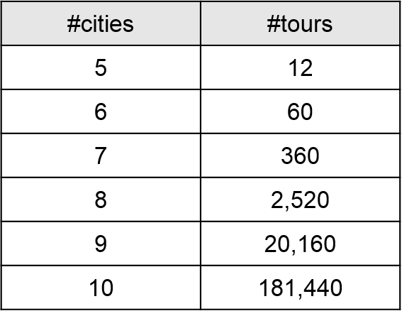
Travelling Salesman Problem (TSP) – Introduction
The number of tours grows exponentially as we add cities to the map,

Slide 40
TSP using Branch and Bound
Here, total minimum distance = sum of row/column minimum = 31
The upper bound = A ⟶B⟶C⟶D⟶E⟶A = 41
Solution : [31…41]
 | A | B | C | D | E
A | -- | 10 | 8 | 9 | 7
B | 10 | -- | 10 | 5 | 6
C | 8 | 10 | -- | 8 | 9
D | 9 | 5 | 8 | -- | 6
E | 7 | 6 | 9 | 6 | --
A
10
B
8
9
10
5
6
7
C
8
D
9
6
E

Slide 41
TSP using Branch and Bound
 | A | B | C | D | E
A | -- | 10 | 8 | 9 | 7
B | 10 | -- | 10 | 5 | 6
C | 8 | 10 | -- | 8 | 9
D | 9 | 5 | 8 | -- | 6
E | 7 | 6 | 9 | 6 | --
$$d_{AB}$$
$$d_{AE}$$
$$d_{AC}$$
$$d_{AD}$$
35
 | A | C | D | E
B | -- | 10 | 5 | 6
C | 8 | -- | 8 | 9
D | 9 | 8 | -- | 6
E | 7 | 9 | 6 | --
$$d_{AB}=10+ 5+8+6+6=35$$
Distance from A to B

Slide 42
TSP using Branch and Bound
 | A | B | C | D | E
A | -- | 10 | 8 | 9 | 7
B | 10 | -- | 10 | 5 | 6
C | 8 | 10 | -- | 8 | 9
D | 9 | 5 | 8 | -- | 6
E | 7 | 6 | 9 | 6 | --
$$d_{AB}$$
$$d_{AE}$$
$$d_{AC}$$
$$d_{AD}$$
35
32
34
31
 | A | C | D | E
B | 10 | -- | 5 | 6
C | -- | 10 | 8 | 9
D | 9 | 5 | -- | 6
E | 7 | 6 | 6 | --
$$d_{AC}=8+ 5+8+5+6=32$$
Distance from A to C

Slide 43
TSP using Branch and Bound
 | A | B | C | D | E
A | -- | 10 | 8 | 9 | 7
B | 10 | -- | 10 | 5 | 6
C | 8 | 10 | -- | 8 | 9
D | 9 | 5 | 8 | -- | 6
E | 7 | 6 | 9 | 6 | --
$$d_{AB}$$
$$d_{AE}$$
$$d_{AC}$$
$$d_{AD}$$
35
32
34
31
$$d_{BA}$$
$$d_{BC}$$
$$d_{BD}$$
36
36
34
 | A | B | D
C | 8 | -- | 8
D | 9 | 5 | --
E | 7 | 6 | 6
For $d_{AE}$ and $d_{BC}=7+10+8+5+6=36$
Distance from A to E
Distance from B to C

Slide 44
TSP using Branch and Bound
 | A | B | C | D | E
A | -- | 10 | 8 | 9 | 7
B | 10 | -- | 10 | 5 | 6
C | 8 | 10 | -- | 8 | 9
D | 9 | 5 | 8 | -- | 6
E | 7 | 6 | 9 | 6 | --
$$d_{AB}$$
$$d_{AE}$$
$$d_{AC}$$
$$d_{AD}$$
35
32
34
31
$$d_{BA}$$
$$d_{BD}$$
$$d_{BC}$$
36
36
34
$$d_{BA}$$
$$d_{BD}$$
$$d_{BE}$$
37
33
33

Slide 45
TSP using Branch and Bound
 | A | B | C | D | E
A | -- | 10 | 8 | 9 | 7
B | 10 | -- | 10 | 5 | 6
C | 8 | 10 | -- | 8 | 9
D | 9 | 5 | 8 | -- | 6
E | 7 | 6 | 9 | 6 | --
$$d_{AB}$$
$$d_{AE}$$
$$d_{AC}$$
$$d_{AD}$$
35
32
34
31
$$d_{BA}$$
$$d_{BD}$$
$$d_{BC}$$
36
36
34
$$d_{BA}$$
$$d_{BD}$$
$$d_{BE}$$
37
33
33
For $d_{AC}+d_{BE}+d_{CB}=8+6+10+9+6=39$
$$d_{CB}$$
$$d_{CE}$$
$$d_{CB}$$
$$d_{CD}$$
For $d_{AC}+d_{BE}+d_{CD}=8+6+8+5+7=34$
36
37
39
34
The optimal route is A – C – D – B – E – A with total cost = 34

Slide 46
Difference between Branch and Bound and Backtracking
Branch and Bound Backtracking
Branch-and-Bound is used to solve optimization problems.
Backtracking is a general algorithm for finding all or some solutions to the computational problems.
A branch-and-bound algorithm consists of a systematic enumeration of candidate solutions. The set of candidate solutions is thought of as forming a rooted tree, the algorithm explores branches of this tree, which represent the subsets of the solution set.
It incrementally builds candidates to the solutions, and backtracks as soon as it determines that the candidate cannot possibly be completed to a valid solution.
Branch-and-Bound traverse the tree in any manner, DFS or BFS.
It traverses the state space tree by DFS(Depth First Search) manner.

Slide 47
Difference between Branch and Bound and Backtracking
Branch and Bound Backtracking
Before enumerating the candidate solutions of a branch, the branch is checked against upper and lower estimated bounds on the optimal solution and is discarded if it cannot produce a better solution than the best one found so far by the algorithm.
It is an algorithmic-technique for solving problems using recursive approach by trying to build a solution incrementally, one piece at a time, removing those solutions that fail to satisfy the constraints of the problem at any point of time.
Branch-and-Bound involves a bounding function.
Backtracking involves feasibility function.
Branch-and-Bound is less efficient.
Backtracking is more efficient.

Slide 48
Mini Max principle

Slide 49
Minimax – Example
Given a given game tree, the optimal strategy can be determined from the minimax value of each node.
MAX prefers to move to a state of maximum value, whereas MIN prefers a state of minimum value.
MAX (player)
3
MIN (opponent)
3
2
2
3
12
8
2
4
6
14
5
2

Slide 50
Minimax - Introduction
The minimax value of a node is the utility (for MAX) of being in the corresponding state, assuming that both players play optimally from there to the end of the game.
The key to the Minimax algorithm is a back and forth between the two players, where the player whose "turn it is" desires to select the move with the maximum score.
In turn, the scores for each of the available moves are determined by the opposing player deciding which of its available moves has the minimum score.
It uses a simple recursive computation of the minimax values of each successor state.
The recursion proceeds all the way down to the leaves of the tree, and then the minimax values are backed up through the tree as the recursion unwinds.

Slide 51
Minimax Algorithm in Game Theory – Tic Tac Toe
Tic-tac-toe is a paper-and-pencil game for two players, X and O, who take turns marking the spaces in a 3×3 grid.
The player who succeeds in placing three of their marks in a horizontal, vertical, or diagonal row wins the game.
Minimax is a recursive algorithm which is used to choose an optimal move for a player assuming that the opponent is also playing optimally.
As its name suggests, its goal is to minimize the maximum loss (minimize the worst case scenario).
To check whether or not the current move is better than the best move we take the help of minimax() function which will consider all the possible ways the game can go and returns the best value for that move, assuming the opponent also plays optimally.

Slide 52
X | X | O
X | O
 | O
Human
Max
WIN
X | X | O
X | O | X
 | O
X | X | O
X | O
X | O
X | X | O
X | O
 | O | X
Computer
Min
WIN
WIN
X | X | O
X | O | X
O | O
X | X | O
X | O | X
 | O | O
X | X | O
X | O
O | O | X
X | X | O
X | O | O
 | O | X
Human
Max
WIN
WIN
X | X | O
X | O | X
X | O | O
X | X | O
X | O | O
X | O | X
Computer
Min

Slide 53

Outline
Introduction
The naive string matching algorithm
The Rabin-Karp algorithm
String Matching with finite automata
The Knuth-Morris-Pratt algorithm
Looping

Slide 54
Introduction
Text-editing programs frequently need to find all occurrences of a pattern in the text.
Efficient algorithms for this problem is called String-Matching Algorithms.
Among its many applications, “String-Matching” is highly used in Searching for patterns in DNA and Internet search engines.
Assume that the text is represented in the form of an array 𝑻[𝟏…𝒏] and the pattern is an array 𝑷[𝟏…𝒎].
Text T[1..13]
a
b
c
a
b
a
a
b
c
a
b
a
c
Pattern P[1..4]
a
b
a
a

Slide 55
Naive String Matching Algorithm

Slide 56
Naive String Matching - Example
The naive algorithm finds all valid shifts using a loop that checks the condition P[1..m] = T[s+1..s+m]
a
c
a
a
b
c
a
c
a
a
b
c
a
c
a
a
b
c
a
a
b
a
a
b
a
a
b
s = 0
s = 1
s = 2
a
c
a
a
b
c
Pattern matched with shift 2
P[1..m] = T[s+1..s+m]
a
a
b
s = 3

Slide 57
Naive String Matching - Algorithm
NAIVE-STRING MATCHER (T,P)
n = T.length
m = P.length
for s = 0 to n-m
if p[1..m] == T[s+1..s+m]
print “Pattern occurs with shift” s
T[1..6]
a
c
a
a
b
c
P[1..3]
a
a
a
a
a
b
a
a
b
b
a
b
2
s = 0
1
3
Pattern occurs with shift 2
Naive String Matcher takes time O((n-m+1)m)

Slide 58
Rabin-Karp Algorithm

Slide 59
Text T
3 | 1 | 4 | 1 | 5 | 9 | 2 | 6 | 5 | 3 | 5
$$ts0 = 31 mod 11 = 9$$
$$ts1 = 14 mod 11 = 3$$
$$ts2 = 41 mod 11 = 8$$
$$ts3 = 15 mod 11 = 4$$
$$ts4 = 59 mod 11 = 4$$
$$ts5 = 92 mod 11 = 4$$
$$ts6 = 26 mod 11 = 4$$
$$ts7 = 65 mod 11 = 10$$
$$ts8 = 53 mod 11 = 9$$
$$ts9 = 35 mod 11 = 2$$
Pattern P
2 | 6
Choose a random prime number q = 11
Let, p = P mod q
= 26 mod 11 = 4
Let t_{s} denotes modulo q for text of length m
3 | 1 | 4 | 1 | 5 | 9 | 2 | 6 | 5 | 3 | 5
9 | 3 | 8 | 4 | 4 | 4 | 4 | 10 | 9 | 2

Slide 60
Pattern P
2 | 6
p = P mod q = 26 mod 11 = 4
2 | 6
Text T
3 | 1 | 4 | 1 | 5 | 9 | 2 | 6 | 5 | 3 | 5
t_{s}
9 | 3 | 8 | 4 | 4 | 4 | 4 | 10 | 9 | 2
Spurious Hit
Valid match
if t_{s} == p
if P[1..m] == T[s+1..s+m]
print “pattern occurs with shift” s

Slide 61
Rabin-Karp Algorithm
We can compute $t_{s}$ using following formula
t_{s+1} = 10(t_{s} - 10^{m-1}T[s+1]) + T[s + m + 1]
3 | 1 | 4 | 1 | 5 | 9 | 2 | 6 | 5 | 3 | 5
For m=2 and s=0 t_{s} = 31
We wish to remove higher order digit T[s+1]=3 and bring the new lower order digit T[s+m+1]=4
t_{s+1} = 10(31-10·3) + 4
= 10(1) + 4 = 14
t_{s+2} = 10(14-10·1) + 1
= 10(4) + 1 = 41

Slide 62
Rabin-Karp-Matcher
RABIN-KARP-MATCHER(T, P, d, q)
n ← length[T];
m ← length[P];
h ← d^{m-1} mod q;
p ← 0;
t₀ ← 0;
for i ← 1 to m do
p ← (d_{p} + P[i]) mod q
t₀ ← (dt₀ + T[i]) mod q
for s ← 0 to n – m do
if p == t_{s} then
if P[1..m] == T[s+1..s+m] then
print “pattern occurs with shift” s
if s < n-m then
t_{s+1} ← (d(t_{s} – T[s+1]h) + T[s+m+1]) mod q
T | 3 | 1 | 4 | 1 | 5 | 9 | 2 | 6 | 5 | 3 | 5
P | 2 | 6
d | 10
q | 11
n | 11
m | 2
h | 10
t₀ | 9
p | 4
t₀ | 0
p | 0

Slide 63
Finite Automata

Slide 64
Introduction to Finite Automata
Finite automaton (FA) is a simple machine, used to recognize patterns.
It has a set of states and rules for moving from one state to another.
It takes the string of symbol as input and changes its state accordingly. When the desired symbol is found, then the transition occurs.
At the time of transition, the automata can either move to the next state or stay in the same state.
When the input string is processed successfully, and the automata reached its final state, then it will accept the input string.
The string-matching automaton is very efficient: it examines each character in the text exactly once and reports all the valid shifts.

Slide 65
Introduction to Finite Automata
A finite automaton M is a 5-tuple, which consists of,
$$(Q,q_{0}, A,Σ,δ)$$
$Q$ is a finite set of states,
$q_{0}ε Q$ is a start state,
$A⊆Q$set of accepting states,
$Σ$is a finite input alphabet,
$δ$ is a transition function of M.
$$Q=\{0,1\}$$
$$q_{0}=0$$
$$A=\{1\}$$
$$Σ=\{a,b\}$$
$$δ\left(1,b\right)=0$$
 | Input
State | a | b
0 | 1 | 0
1 | 0 | 0
a
b
0
1
a
b
Transition Table
Finite Automaton

Slide 66
Suffix of String
Suffix of a string is any number of trailing symbols of that string. If a string $ω$ is a suffix of a string $x$ then it is denoted by $ω⊐x$.
$$P = ababa$$
$$P_{1}=a$$ | $$P_{1}⊐P$$
$$P_{2}=ba$$ | $$P_{2}⊐P$$
$$P_{3}=aba$$ | $$P_{3}⊐P$$
$$P_{4}=baba$$ | $$P_{4}⊐P$$
$$P_{5}=ababa=P$$ | $$P_{5}⊐P$$

Slide 67
Compute Transition Function
COMPUTE-TRANSITION-FUNCTION(P, Σ )
m ← length[P]
for q ← 0 to m do
for each character $ω$ Є Σ do
k ← min(m + 1, q + 2)
repeat k ← k – 1 until P_{k} ⊐ P_{q}α
δ(q, α) ← k
return δ

Slide 68
 | 1 | 2 | 3 | 4 | 5 | 6 | 7
Pattern | a | b | a | b | a | c | a
for q ← 0 to m do
for each character $ω$ Є Σ do
k ← min(m + 1, q + 2)
repeat k ← k – 1 until P_{k} ⊐ P_{q} $ω$
δ(q, $ω$) ← k
return δ
Σ = {a, b, c}
1 | 2 | 3 | 4 | 5 | 6 | 7
m = 7
 | input
State | a | b | c
0 | 1 | 0 | 0
1
2
3
4
5
6
7
q=0 | ω=a | k=2 | P₂⊐P₀ω | ab⊐ϵa
k=1 | P₁⊐P₀ω | a⊐ϵa
ω=b | k=2 | P₂⊐P₀ω | ab⊐ϵb
k=1 | P₁⊐P₀ω | a⊐ϵb
k=0 | P₀⊐P₀ω | ϵ⊐ϵb
ω=c | k=2 | P₂⊐P₀ω | ab⊐ϵc
k=1 | P₁⊐P₀ω | a⊐ϵc
k=0 | P₀⊐P₀ω | ϵ⊐ϵc

Slide 69
 | 1 | 2 | 3 | 4 | 5 | 6 | 7
Pattern | a | b | a | b | a | c | a
for q ← 0 to m do
for each character $ω$ Є Σ do
k ← min(m + 1, q + 2)
repeat k ← k – 1 until P_{k} ⊐ P_{q} $ω$
δ(q, $ω$) ← k
return δ
Σ = {a, b, c}
1 | 2 | 3 | 4 | 5 | 6 | 7
m = 7
 | input
State | a | b | c
0 | 1 | 0 | 0
1 | 1 | 2 | 0
2
3
4
5
6
7
q=1 | ω=a | k=3 | P₃⊐P₁ω | aba⊐aa
k=2 | P₂⊐P₁ω | ab⊐aa
k=1 | P₁⊐P₁ω | a⊐aa
ω=b | k=3 | P₃⊐P₁ω | aba⊐ab
k=2 | P₂⊐P₁ω | ab⊐ab
ω=c | k=3 | P₃⊐P₁ω | aba⊐ac
k=2 | P₂⊐P₁ω | ab⊐ac
k=1 | P₁⊐P₁ω | a⊐ac
k=0 | P₀⊐P₁ω | ϵ⊐ac

Slide 70
 | 1 | 2 | 3 | 4 | 5 | 6 | 7
Pattern | a | b | a | b | a | c | a
for q ← 0 to m do
for each character $ω$ Є Σ do
k ← min(m + 1, q + 2)
repeat k ← k – 1 until P_{k} ⊐ P_{q} $ω$
δ(q, $ω$) ← k
return δ
Σ = {a, b, c}
1 | 2 | 3 | 4 | 5 | 6 | 7
m = 7
 | input
State | a | b | c
0 | 1 | 0 | 0
1 | 1 | 2 | 0
2 | 3 | 0 | 0
3 | 1 | 4 | 0
4 | 5 | 0 | 0
5 | 1 | 4 | 6
6 | 7 | 0 | 0
7 | 1 | 2 | 0
q=2 | ω=a | k=4 | P₄⊐P₂ω | abab⊐aba
k=3 | P₃⊐P₂ω | aba⊐aba
ω=b | k=0 | P₀⊐P₂ω | ϵ⊐abb
ω=c | k=0 | P₀⊐P₂ω | ϵ⊐abc
q=3 | ω=a | k=1 | P₁⊐P₃ω | a⊐abaa
ω=b | k=4 | P₄⊐P₃ω | abab⊐abab
ω=c | k=0 | P₀⊐P₃ω | ϵ⊐abac

Slide 71
Finite Automata Matcher
FINITE-AUTOMATON MATCHER(T, δ, m)
n ← length[T]
q ← 0
for i ← 1 to n do
q ← δ(q, T[i])
if q == m then
print "Pattern occurs with shift" i – m
$$q=δ(0,a)=1$$
$$q=δ(1,b)=2$$
$$q=δ(2,a)=3$$
$$q=δ(3,b)=4$$
$$q=δ(4,a)=5$$
$$q=δ(5,b)=4$$
$$q=δ(4,a)=5$$
$$q=δ(5,c)=6$$
$$q=δ(6,a)=7$$
 | input
State | a | b | c
0 | 1 | 0 | 0
1 | 1 | 2 | 0
2 | 3 | 0 | 0
3 | 1 | 4 | 0
4 | 5 | 0 | 0
5 | 1 | 4 | 6
6 | 7 | 0 | 0
7 | 1 | 2 | 0
i =
6
3
1
8
5
9
4
2
7
q =
6
4
5
4
0
1
2
5
3
7
 | 1 | 2 | 3 | 4 | 5 | 6 | 7
Pattern | a | b | a | b | a | c | a
 | 1 | 2 | 3 | 4 | 5 | 6 | 7 | 8 | 9 | 10 | 11
Text | a | b | a | b | a | b | a | c | a | b | a

Slide 72
Finite Automata Matcher
FINITE-AUTOMATON MATCHER(T, δ, m)
n ← length[T]
q ← 0
for i ← 1 to n do
q ← δ(q, T[i])
if q == m then
print "Pattern occurs with shift" i – m
$$q=δ(0,a)=1$$
$$q=δ(1,b)=2$$
$$q=δ(2,a)=3$$
$$q=δ(3,b)=4$$
$$q=δ(4,a)=5$$
$$q=δ(5,b)=4$$
$$q=δ(4,a)=5$$
 | input
State | a | b | c
0 | 1 | 0 | 0
1 | 1 | 2 | 0
2 | 3 | 0 | 0
3 | 1 | 4 | 0
4 | 5 | 0 | 0
5 | 1 | 4 | 6
6 | 7 | 0 | 0
7 | 1 | 2 | 0
i =
6
3
1
5
4
2
7
q =
4
5
4
0
1
2
5
3
 | 1 | 2 | 3 | 4 | 5 | 6 | 7
Pattern | a | b | a | b | a | c | a
 | 1 | 2 | 3 | 4 | 5 | 6 | 7 | 8 | 9 | 10 | 11
Text | a | b | a | b | a | b | a | c | a | b | a

Slide 73
Finite Automata Matcher
FINITE-AUTOMATON MATCHER(T, δ, m)
n ← length[T]
q ← 0
for i ← 1 to n do
q ← δ(q, T[i])
if q == m then
print "Pattern occurs with shift" i – m
$$q=δ(0,a)=1$$
$$q=δ(1,b)=2$$
$$q=δ(2,a)=3$$
$$q=δ(3,b)=4$$
$$q=δ(4,a)=5$$
$$q=δ(5,b)=4$$
$$q=δ(4,a)=5$$
$$q=δ(5,c)=6$$
$$q=δ(6,a)=7$$
 | input
State | a | b | c
0 | 1 | 0 | 0
1 | 1 | 2 | 0
2 | 3 | 0 | 0
3 | 1 | 4 | 0
4 | 5 | 0 | 0
5 | 1 | 4 | 6
6 | 7 | 0 | 0
7 | 1 | 2 | 0
i =
8
9
6
3
1
5
4
2
7
q =
6
4
5
4
7
0
1
2
5
3
 | 1 | 2 | 3 | 4 | 5 | 6 | 7
Pattern | a | b | a | b | a | c | a
 | 1 | 2 | 3 | 4 | 5 | 6 | 7 | 8 | 9 | 10 | 11
Text | a | b | a | b | a | b | a | c | a | b | a

Slide 74
Suffix & Prefix of a String
Suffix of a string
$$P =string$$
$$P_{1}=g$$ | $$P_{1}⊐P$$
$$P_{2}=ng$$ | $$P_{2}⊐P$$
$$P_{3}=ing$$ | $$P_{3}⊐P$$
$$P_{4}=ring$$ | $$P_{4}⊐P$$
$$P_{5}=tring$$ | $$P_{5}⊐P$$
Prefix of a string
$P =string$
$$P_{1}=s$$ | $$P_{1}⊏P$$
$$P_{2}=st$$ | $$P_{2}⊏P$$
$$P_{3}=str$$ | $$P_{3}⊏P$$
$$P_{4}=stri$$ | $$P_{4}⊏P$$
$$P_{5}=strin$$ | $$P_{5}⊏P$$

Slide 75
Knuth-Morris-Pratt Algorithm
The KMP algorithm relies on prefix function (π).
Proper prefix: All the characters in a string, with one or more cut off the end. “S”, “Sn”, “Sna”, and “Snap” are all the proper prefixes of “Snape”.
Proper suffix: All the characters in a string, with one or more cut off the beginning. “agrid”, “grid”, “rid”, “id”, and “d” are all proper suffixes of “Hagrid”.
KMP algorithm works as follows:
Step-1: Calculate Prefix Function
Step-2: Match Pattern with Text

Slide 76
Longest Common Prefix and Suffix
 | 1 | 2 | 3 | 4 | 5 | 6 | 7
Pattern | a | b | a | b | a | c | a
Prefix(π) | 0 | 0 | 1 | 2 | 3 | 0 | 1
ababa
abab
aba
ab
a
We have no possible prefixes
Possible prefix = a
Possible prefix = a, ab, aba, abab
Possible prefix = a, ab
Possible prefix = a, ab, aba
We have no possible suffixes
Possible suffix = b
Possible suffix = a, ba, aba, baba
Possible suffix = a, ba
Possible suffix = b, ab, bab

Slide 77
Longest Common Prefix and Suffix
 | 1 | 2 | 3 | 4 | 5 | 6 | 7 | 8 | 9 | 10
Pattern | a | b | c | d | a | b | e | a | b | f
Prefix(π) | 0 | 0 | 0 | 0 | 1 | 2 | 0 | 1 | 2 | 0
 | 1 | 2 | 3 | 4 | 5 | 6 | 7 | 8 | 9 | 10 | 11
Pattern | a | b | c | d | e | a | b | f | a | b | c
Prefix(π) | 0 | 0 | 0 | 0 | 0 | 1 | 2 | 0 | 1 | 2 | 3
 | 1 | 2 | 3 | 4 | 5 | 6 | 7 | 8 | 9 | 10
Pattern | a | a | b | c | a | d | a | a | b | e
Prefix(π) | 0 | 1 | 0 | 0 | 1 | 0 | 1 | 2 | 3 | 0
 | 1 | 2 | 3 | 4 | 5 | 6 | 7 | 8 | 9
Pattern | a | a | a | a | b | a | a | c | d
Prefix(π) | 0 | 1 | 2 | 3 | 0 | 1 | 2 | 0 | 0

Slide 78
Calculate Prefix Function - Example
k+1
q
q
k+1
 | 1 | 2 | 3 | 4 | 5 | 6 | 7
P | a | c | a | c | a | g | t
π | 0 | 0 | 1 | 2 | 3 | 0 | 0
false
P[k+1]==P[q]
true
k =
0
1
2
3
1
0
q =
2
3
4
5
6
7
false
k>0
true
Initially set π[1] = 0
k is the longest prefix found
q is the current index of pattern
k=π[k]
k=k+1
π[q]=k

Slide 79
KMP- Compute Prefix Function
COMPUTE-PREFIX-FUNCTION(P)
m ← length[P]
π[1] ← 0
k ← 0
for q ← 2 to m
while k > 0 and P[k + 1] ≠ P[q]
k ← π[k]
end while
if P[k + 1] == P[q] then
k ← k + 1
end if
π[q] ← k
return π

Slide 80
KMP String Matching
 | 1 | 2 | 3 | 4 | 5 | 6 | 7
Pattern | a | c | a | c | a | g | t
Prefix(π) | 0 | 0 | 1 | 2 | 3 | 0 | 0
Next valid shift $s^{,}=s+(q−π\left[q\right])$
T | a | c | a | t | a | c | g | a | c | a | c | a | g | t
Mismatch ?
Check value in prefix table
a
c
a
c
a
g
t
a
c
a
c
a
g
t
We can skip 2 shifts
(Skip unnecessary shifts)
T | a | c | a | t | a | c | g | a | c | a | c | a | g | t
a
c
a
c
a
g
t
Mismatch ?
Check value in prefix table
T | a | c | a | t | a | c | g | a | c | a | c | a | g | t
a
c
a
c
a
g
t
Mismatch ?
Check value in prefix table

Slide 81
KMP String Matching
 | 1 | 2 | 3 | 4 | 5 | 6 | 7
Pattern | a | c | a | c | a | g | t
Prefix(π) | 0 | 0 | 1 | 2 | 3 | 0 | 0
Next valid shift $s^{,}=s+(q−π\left[q\right])$
T | a | c | a | t | a | c | g | a | c | a | c | a | g | t
Mismatch ?
Check value in prefix table
a
c
a
c
a
g
t
We can skip 2 shifts
(Skip unnecessary shifts)
T | a | c | a | t | a | c | g | a | c | a | c | a | g | t
a
c
a
c
a
g
t
T | a | c | a | t | a | c | g | a | c | a | c | a | g | t
a
c
a
c
a
g
t
Pattern matches with shift $i−m$

Slide 82
KMP-MATCHER
KMP-MATCHER(T, P)
n ← length[T]
m ← length[P]
π ← COMPUTE-PREFIX-FUNCTION(P)
q ← 0 //Number of characters matched.
for i ← 1 to n //Scan the text from left to right.
while q > 0 and P[q + 1] ≠ T[i]
q ← π[q] //Next character does not match.
if P[q + 1] == T[i] then
then q ← q + 1 //Next character matches.
if q == m then //Is all of P matched?
print "Pattern occurs with shift" i - m
q ← π[q] //Look for the next match.

Slide 83

Outline
The class P and NP
Polynomial reduction
NP- Completeness Problem
NP-Hard Problems
Travelling Salesman problem
Hamiltonian problem
Approximation algorithms
Randomized algorithms
Class of problems beyond NP – P SPACE
Looping

Slide 84
The class P and NP

Slide 85
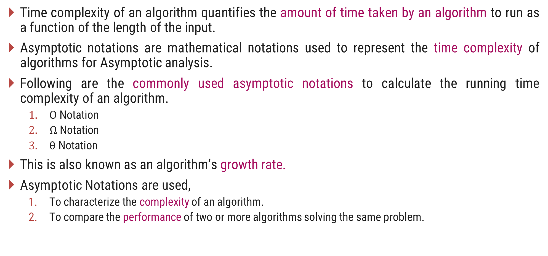
Time Complexity of an Algorithm
Time complexity of an algorithm quantifies the amount of time taken by an algorithm to run as a function of the length of the input.
Asymptotic notations are mathematical notations used to represent the time complexity of algorithms for Asymptotic analysis.
Following are the commonly used asymptotic notations to calculate the running time complexity of an algorithm.
$Ο$ Notation
$Ω$ Notation
$θ$ Notation
This is also known as an algorithm’s growth rate.
Asymptotic Notations are used,
To characterize the complexity of an algorithm.
To compare the performance of two or more algorithms solving the same problem.

Slide 86
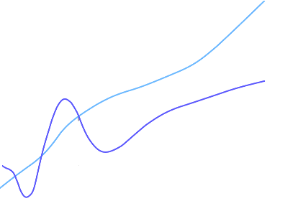
Big($O$) Notation
$g(n)$ is an asymptotically upper bound for $f(n)$.
$f(n)=O(g(n))$implies:
$$f\left(n\right)“≤” c.g(n)$$
An upper bound $g(n)$ of an algorithm defines the maximum time required, we can always solve the problem in at most $g(n)$ time.
Time taken by a known algorithm to solve a problem with worse case input gives the upper bound.
$$c.g(n)$$
$$f(n)$$
$$n$$
$$n_{0}$$
$$f(n)=O(g(n))$$

Slide 87
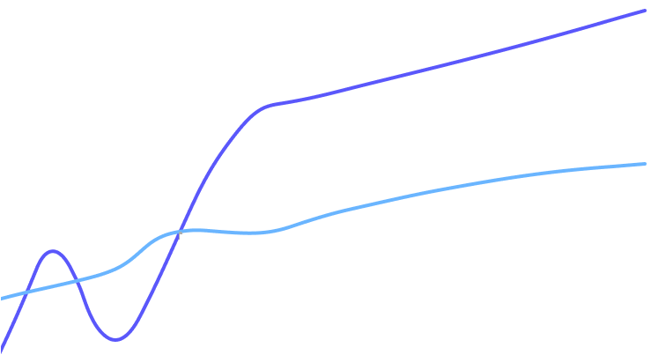
Big($Ω$) Notation
$g(n)$is an asymptotically lower bound for $f(n).$
$f(n)= Ω(g(n))$implies:
$$f(n)“≥” c.g(n)$$
A lower bound $g(n)$of an algorithm defines the minimum time required, it is not possible to have any other algorithm (for the same problem) whose time complexity is less than $g(n)$ for random input.
$$f(n)$$
$$c.g(n)$$
$$n$$
$$n_{0}$$
$$f(n)=Ω(g(n))$$

Slide 88
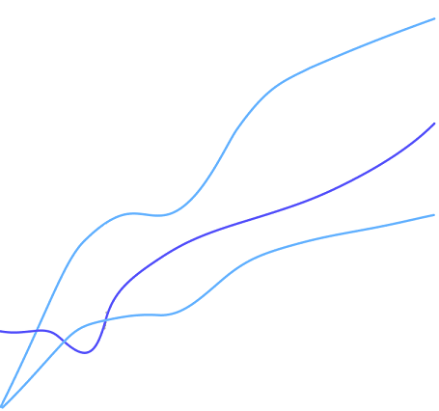
$θ$-Notation
$θ(g(n))$is a set, we can write $f(n) ε θ(g(n))$to indicate that $f(n)$is a member of $θ(g(n)).$
$g(n)$is an asymptotically tight bound for $f(n).$
$f(n)=θ(g(n))$implies:
$$f(n)“=” c.g(n)$$
$$c_{2}.g(n)$$
$$f(n)$$
$$c_{1}.g(n)$$
$$n$$
$$n_{0}$$
$$f(n)=θ(g(n))$$

Slide 89

Exponential Complexity
Fibonacci example – the recursive fib cannot even compute fib(50)

Slide 90
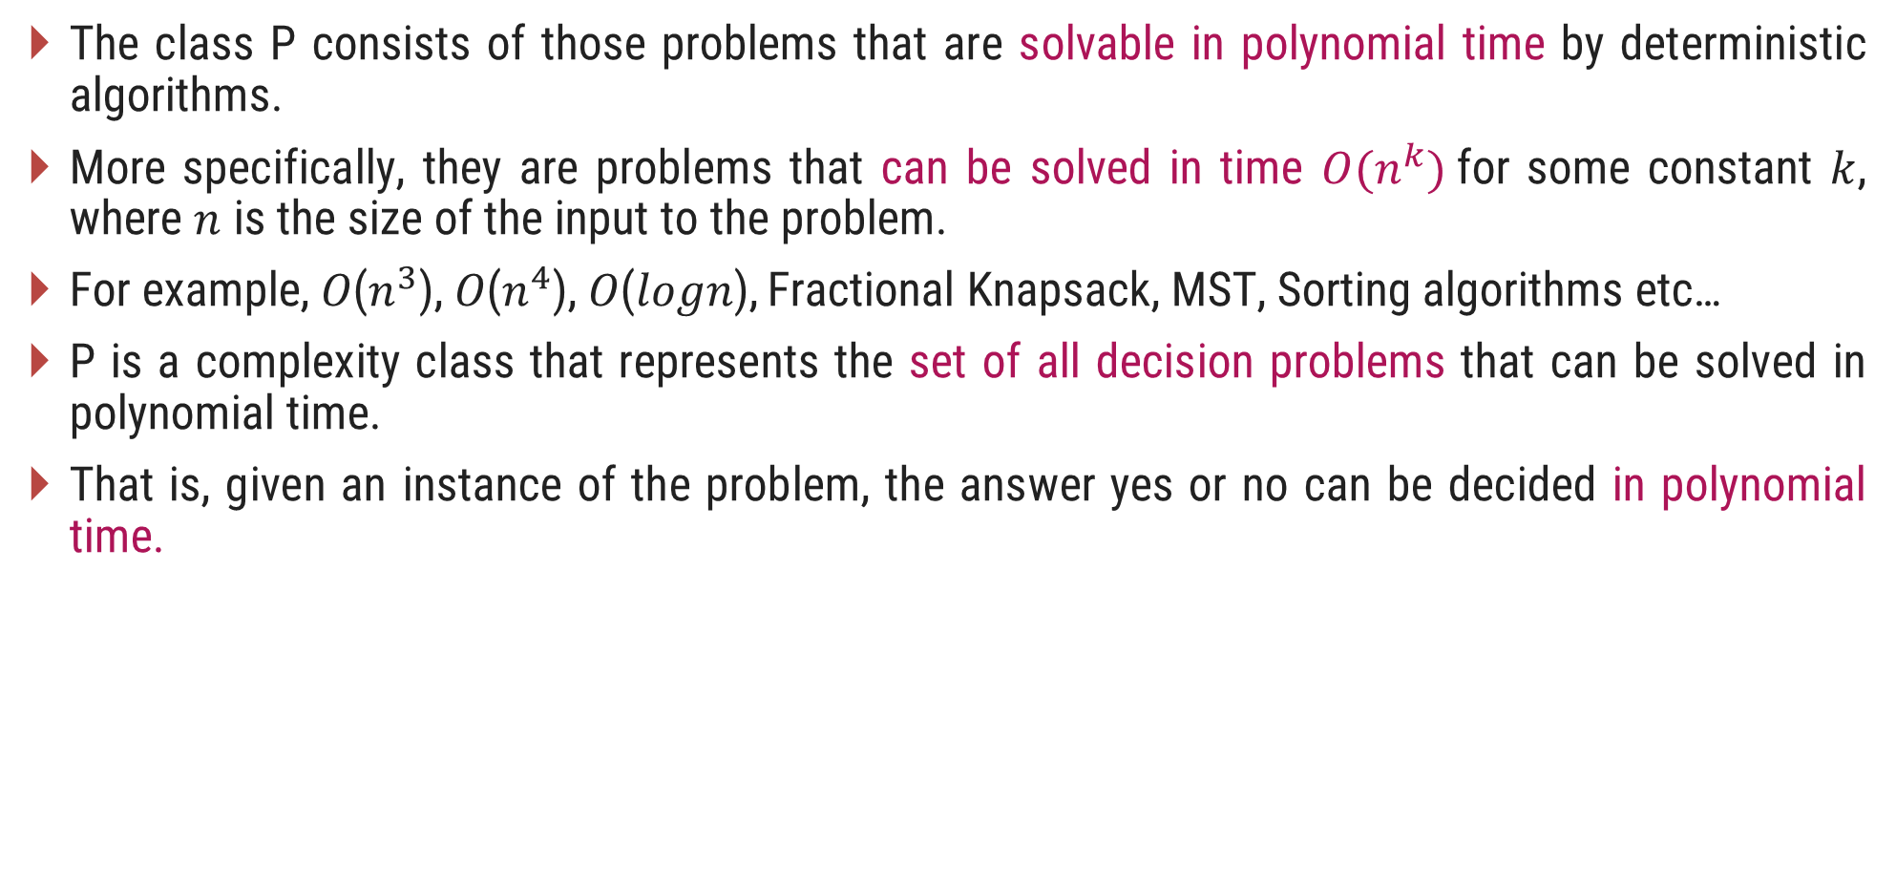
The Class P
The class P consists of those problems that are solvable in polynomial time by deterministic algorithms.
More specifically, they are problems that can be solved in time $O(n^{k})$for some constant $k$, where $n$ is the size of the input to the problem.
For example, 𝑂($n^{3}$), 𝑂($n^{4}$), 𝑂(𝑙𝑜𝑔𝑛), Fractional Knapsack, MST, Sorting algorithms etc…
P is a complexity class that represents the set of all decision problems that can be solved in polynomial time.
That is, given an instance of the problem, the answer yes or no can be decided in polynomial time.

Slide 91
The NP class
NP is Non-Deterministic polynomial time.
The class NP consists of those problems that are verifiable in polynomial time.
NP is the class of decision problems for which it is easy to check the correctness of a claimed answer, with the help of a little extra information.
Hence, we are not asking for a way to find a solution, but only to verify that an alleged solution really is correct.
Every problem in this class can be solved in exponential time using exhaustive search.

Slide 92
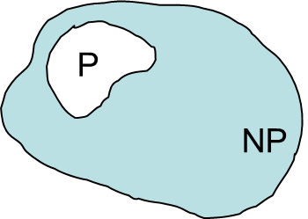
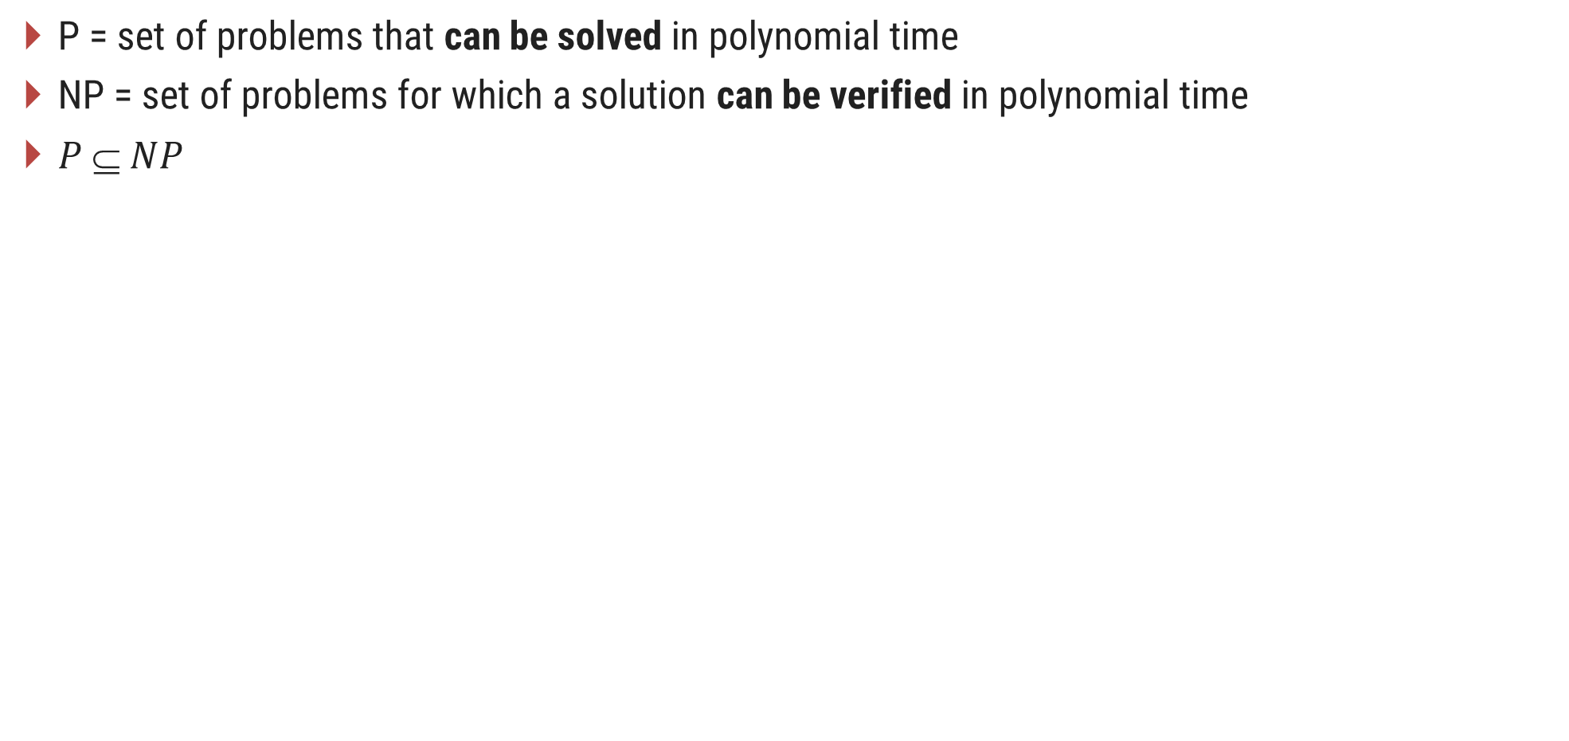
P and NP Class Problems
P = set of problems that can be solved in polynomial time
NP = set of problems for which a solution can be verified in polynomial time
$P  NP$

Slide 93
Classification of NP Problems
NP Complete
NP-complete problems are a set of problems to each of which any other NP-problem can be reduced in polynomial time, and whose solution may still be verified in polynomial time.
No polynomial-time algorithm has been discovered for an NP-Complete problem.
NP-Complete is a complexity class which represents the set of all problems X in NP for which it is possible to reduce any other NP problem Y to X in polynomial time.
NP Hard
NP-hard problems are those at least as hard as NP problems, i.e., all NP problems can be reduced (in polynomial time) to them.
NP-hard problems need not be in NP, i.e., they need not have solutions verifiable in polynomial time.
The precise definition here is that a problem X is NP-hard, if there is an NP-complete problem Y, such that Y is reducible to X in polynomial time.

Slide 94
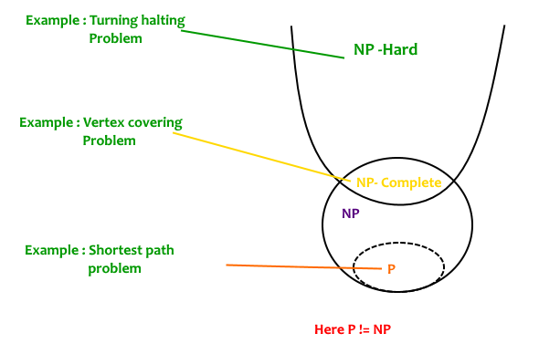
P, NP Complete and NP Hard

Slide 95
Polynomial Reduction

Slide 96
Introduction
Let us consider a decision problem A, which we would like to solve in polynomial time.
Now suppose, we already know how to solve a different decision problem B in polynomial time.
Finally we have a procedure that transforms any instance α of A into some instance β of B with the following characteristics.
The transformation takes polynomial time.
The answers are same. That is the answer for α is “yes” if and only if the answer of β is also “yes”.
We call such a procedure a polynomial-time reduction algorithm and it provides us a way to solve problem A in polynomial time:

Slide 97
Polynomial Reduction
Given an instance α of problem A, use a polynomial-time reduction algorithm to transform it to an instance β of problem B.
Run the polynomial-time decision algorithm for B on the instance β.
Use the answer for β as the answer for α.
In other words, by "reducing" solving problem A to solving problem B, we use the "easiness" of B to prove the "easiness" of A.
Yes
α
Polynomial time Reduction Algorithm
β
Polynomial time Algorithm to decide B
No
Polynomial time Algorithm to decide A

Slide 98
NP Hard Problems

Slide 99
Hamiltonian Cycles
Hamiltonian Path in an undirected graph is a path that visits each vertex exactly once.
A Hamiltonian cycle (or Hamiltonian circuit) is a Hamiltonian Path such that there is an edge (in the graph) from the last vertex to the first vertex of the Hamiltonian Path.
Given a list of vertices and to check whether it forms a Hamiltonian cycle or not:
Counts the vertices to make sure they are all there, then checks that each is connected to the next by an edge, and that the last is connected to the first.
1
2
3
4
The graph has Hamiltonian cycles:
1, 3, 4, 5, 6, 7, 8, 2, 1 and 1, 2, 8, 7, 6, 5, 4, 3, 1.
8
7
6
5

Slide 100
Hamiltonian Cycles
It takes time proportional to 𝑛, because there are 𝑛 vertices to count and 𝑛 edges to check. 𝑛 is a polynomial, so the check runs in polynomial time.
To find a Hamiltonian cycle from the given graph: There are 𝑛! different sequences of vertices that might be Hamiltonian paths in a given 𝑛-vertex graph, so a brute force search algorithm that tests all possible sequences can not be solved in polynomial time.
In the traveling salesman Problem, a salesman must visits n cities.
We can say that salesman wishes to make a tour or Hamiltonian cycle, visiting each city exactly once and finishing at the city he starts from.

Slide 101
Hamiltonian Cycles
In TSP, we find a tour and check that the tour contains each vertex once. Then the total cost of the edges of the tour is calculated.
How would you verify that the solution you're given really is the shortest loop? In other words, how do you know there's not another loop that's shorter than the one given to you?
The only known way to verify that a provided solution is the shortest possible solution is to actually solve TSP.
Since it takes exponential time to solve NP, the solution cannot be checked in polynomial time. Thus this problem is NP-hard, but not in NP.

Slide 102
Thank You!

